Slide 1

Motion Estimation
Will.Tan
2016.11.12

Slide 2

一、双目的性能
CPU | GPU | VeryFast |  | VeryFast+ground plane |  | VeryFast+stixel |  | stixel_world | stixel_world+estimate_motion
 |  | article(Hz) | fps | article(Hz) | fps | article(Hz) | fps | fps | fps
i5-4200U,1.60GHz | GeForce GT 740M | 11.10 | 7.35 | 12.88 | 8.06 | 21.60 | 10.64 | 17.85 | 5.46
i7-2630QM,2.00GHz | GeForce GTX 560M | 20 | — | 38 | — | 80 | — | — | —
i7-xxxxx, | GeForce GT 470 | — | — | — | — | 145 | — | — | —

Slide 3
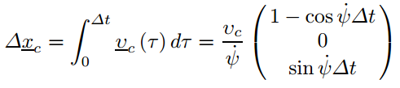

二、运动估计
KLT Tracker + EKF
The movement of a vehicle with constant velocity and yaw rate over the time interval can be described in this coordinate system as
the position of a world point
System Model
[1] 6D-Vision Fusion of Stereo and Motion for Robust Environment Perception

Slide 4
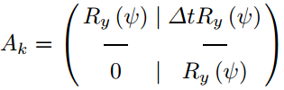
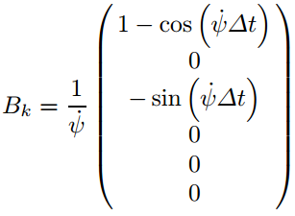
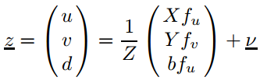
二、运动估计
state transition matrix：
control matrix：
Measurement Model
a point given in the camera coordinate system
[1] 6D-Vision Fusion of Stereo and Motion for Robust Environment Perception

Slide 5
三、参考文献
[1] Pixels, Stixels, and Objects
[2] 6D-Vision Fusion of Stereo and Motion for Robust Environment Perception
[3] Dense, Robust, and Accurate Motion Field Estimation from Stereo Image Sequences in Real-Time
[4] Feature- and Depth-Supported Modified Total Variation Optical Flow for 3D Motion Field Estimation in Real Scenes
[5] Where Will the Oncoming Vehicle be the Next Second

Slide 6
四、下一周计划
1.继续阅读上述所列文章，弄清楚6D-Vision的原理及近况研究。
2.搜罗阅读路边检测相关方面的文章

Slide 7

Q & A

